Slide 1

Project Title
Indian Air Quality Index Analysis
(AQI)

Slide 2
Contents
Chapter 1 – Introduction
Chapter 2 – Technology stack & Data Cleaning
Chapter 3 – Project Portfolio & Analysis
Chapter 4 – Conclusion
Project Results
Thank You

Slide 3
Chapter 1: Introduction
Internship Overview
Completed a one-month Data Analytics Internship at Algorism
Learned Python programming and Power BI basics
Worked on real-world AQI dataset analysis
Performed data cleaning and preprocessing using Pandas
Created charts and visualizations using Matplotlib
Built interactive dashboards in Power BI
Learned real-world data analytics workflow and reporting skills

Slide 4
1.2 Objectives
To analyze Indian air quality data
To clean missing and inconsistent data
To identify highly polluted cities
To study AQI trends over time
To visualize pollution data using charts
To understand the relationship between pollutants and AQI

Slide 5
Chapter 2: Technology Stack & Data Cleaning
2.1 Technologies Used
Pandas
NumPy
Matplotlib
Power BI
2.2 Dataset Information
Dataset Name: Indian Air Quality Index (AQI) Dataset
File Name: AQI_city_day.csv
The dataset contains daily air pollution records collected from different Indian cities. It includes AQI values and pollutant concentrations used to measure air quality levels and environmental conditions.

Slide 6
Total Columns:
16 Columns
Total Rows:
29,531
Primary Columns in the AQI Dataset
City
Date
PM2.5
PM10
NO2
CO
SO2
AQI
AQI_Bucket

Slide 7
2.3 Data Cleaning
Missing Value Detection
AQI Median Filling
Date Conversion
Duplicate Removal
Feature Engineering
Health Risk Classification
Python Functions Used:
.isnull().sum()
.fillna()
.drop_duplicates()
.groupby()

Slide 8
Chapter 3: Project Overview
Project Title:
Indian Air Quality Index (AQI) Analysis
Project Goal:
Analyze pollution trends
Identify polluted cities
Study AQI impact
Create visual reports

Slide 9
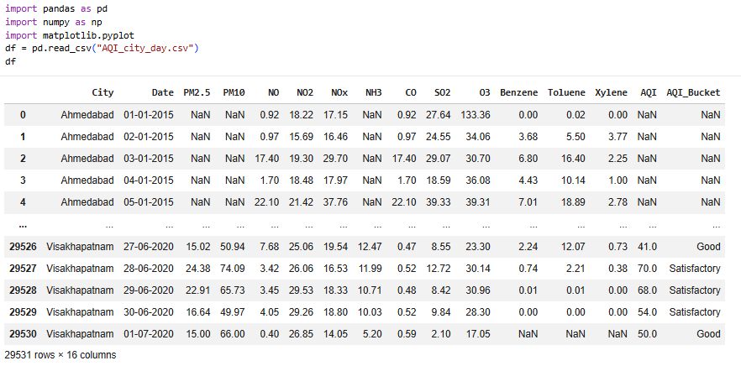
3.1 Data Processing Steps:
Steps Performed During Data Processing
Dataset Loading
Imported AQI dataset using Pandas

Slide 10
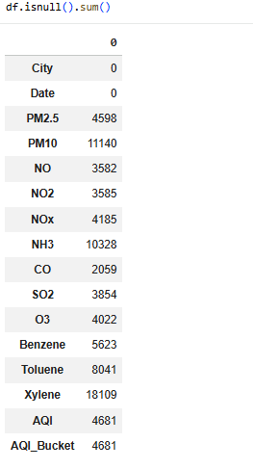
2. Missing Value Detection
Identified null values using .isnull().sum()

Slide 11
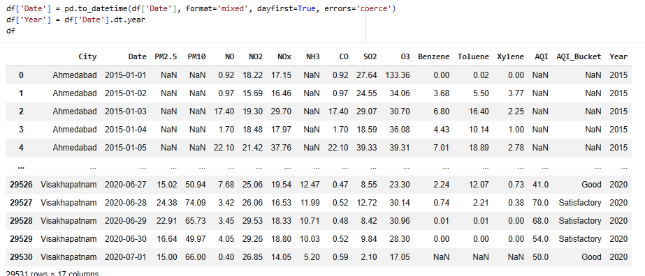
3. Date Formatting
Converted Date column into datetime format
Extracted Year column for yearly analysis

Slide 12
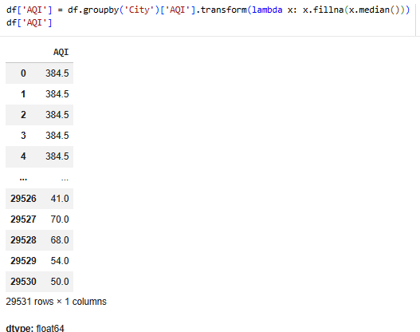
4. AQI Median Replacement
Filled missing AQI values using city-wise median AQI

Slide 13
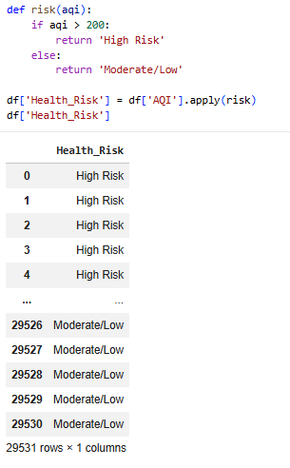
5. Feature Engineering
Created new column: Health_Risk
Classified AQI into pollution risk categories

Slide 14
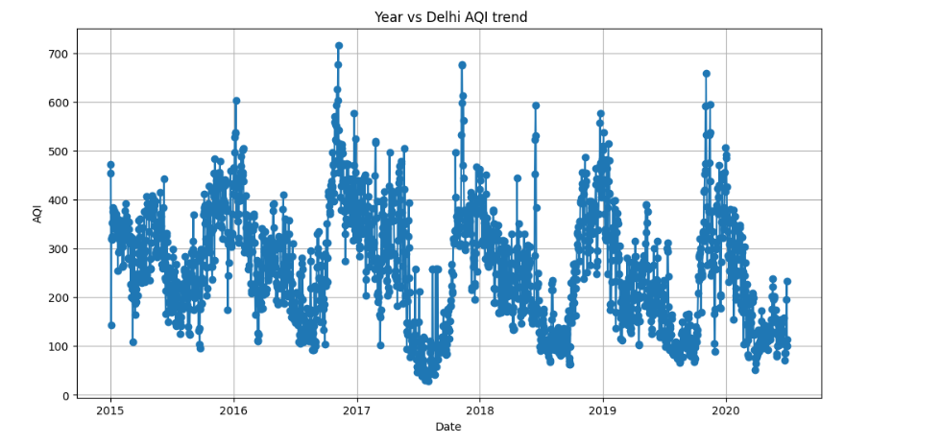
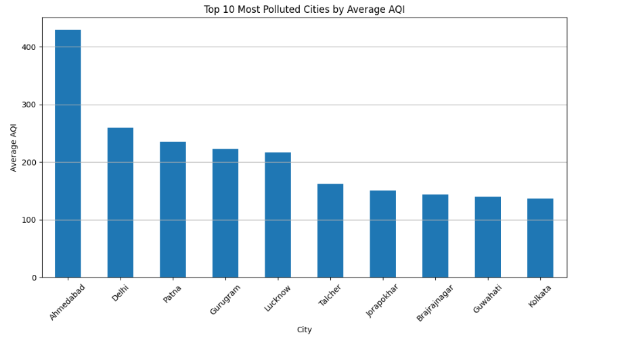
3.2 Visual Analysis
AQI Trend Line Chart
Top 10 Polluted Cities Bar Chart

Slide 15
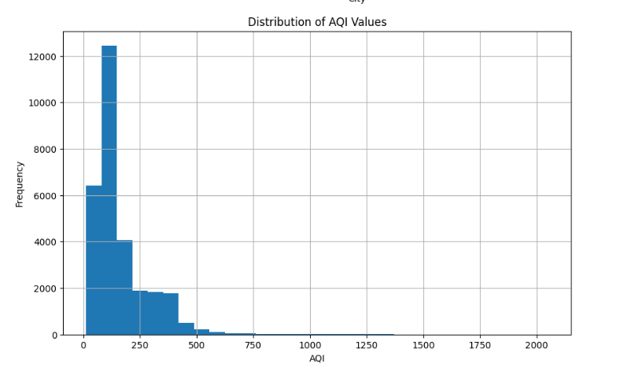
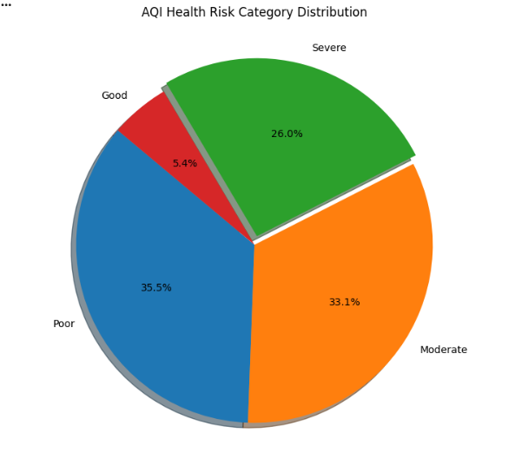
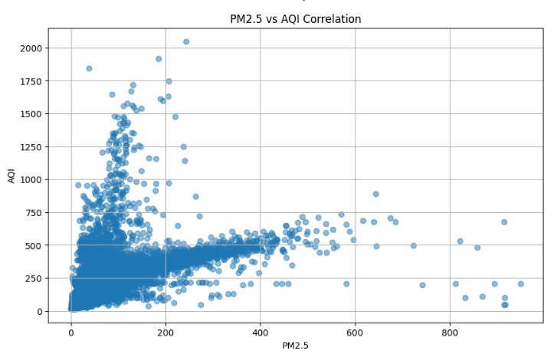
AQI Distribution Histogram
AQI Health Risk Pie Chart
PM2.5 vs AQI Scatter Plot

Slide 16
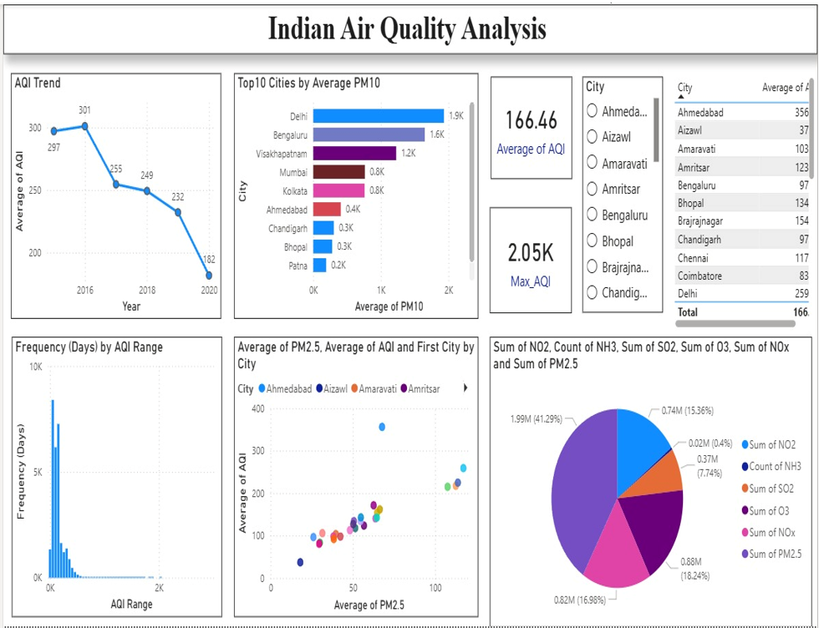
3.3 Power BI Dashboard

Slide 17
Chapter 4: Observations and Conclusion
Observations:
Delhi recorded very high AQI
PM2.5 strongly affected AQI
Urban cities showed severe pollution
Seasonal AQI fluctuations observed
Many records were in unhealthy AQI categories
Conclusion:
Successfully analyzed AQI data
Cleaned and visualized pollution dataset
Learned practical Python analytics
Built interactive Power BI dashboards
Improved analytical skills

Slide 18
About Project & Results
About Project:
Real-world environmental analysis project
Used Python and Power BI
Focused on Indian AQI dataset
Results:
Identified highly polluted cities
Found AQI pollution patterns
Created professional visualizations
Improved environmental understanding

Slide 19
2nd May, 2030
THANK YOU

